Slide 1

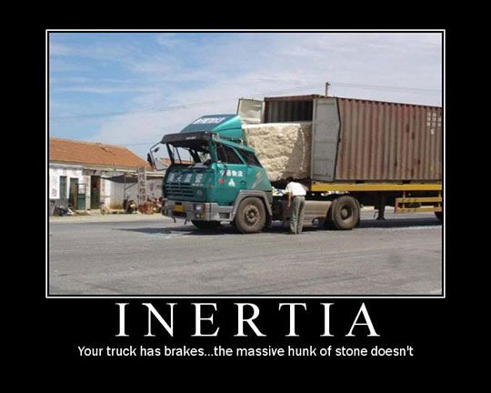
Newton’s 1st Law

Slide 2
Newton’s Laws
https://www.youtube.com/watch?v=8yis7GzlXNM
Isaac Newton was an English Scientist.
He was born in 1643 at a time when the laws of nature were a mystery.
He studied maths and physics, and is perhaps best known for discovering gravity.
He described it as a ‘pulling force’, and even deduced that it was responsible for keeping the Moon in orbit.

Slide 3
Newton’s Laws
To appreciate Newton’s laws of motion, it is important to understand the concept of force.
A force is a push or a pull acting upon an object as a result of its interaction with another object.
Force has the symbol F and is measured in the unit newtons (N).

Slide 4
Newton’s 1st Law
An object at rest will remain this way unless it is acted upon by a force.
An object that is moving will continue to move at the same speed and in the same direction unless an unbalanced force acts upon it.

Slide 5
Inertia
The tendency to resist any change in motion is called an object’s inertia.
When you are on a fast train and the train brakes suddenly, your body will lurch forward. This is because the brakes are acting on the train and not your whole body. Your feet will slow down, but your body won’t.

Slide 6
Car Crashes
If you are travelling in a car at 60 km/h that is suddenly brought to a stop, then your body continues to travel forwards at 60 km/h.
Seat belts restrain your body so that you stop with the car.
Airbags reduces the force on a passenger.
Reducing the spread of infectious disease as long as people are immunised

Slide 7
1st Law - Inertia
https://www.youtube.com/watch?v=erghLWXDScI

Slide 8
State whether the objects are balanced or unbalanced forces and which way they will move
4N
4N
2N
A
5N
3N
B
C
2N
3N
3N
E
2N
D
2N
2N
3N
F
4N
G
4N
3N
2N

Slide 9
Task – copy and complete the table. What happens in each box?
SUPPORT:
Remains stationary
Speeds up / Slows down
Constant speed
Starts accelerating
 | Stationary object | Moving object
Zero resultant force applied.
Non-zero resultant force applied
Stretch: A car needs a force of 2000N to push it forward. The engine provides 2500N, why do you think this is?

